Slide 1


Slide 2


Stakeholders
Sponsors
Flipkart
L&D Coordinator
Deepika Gajaraj
Order Training
Sakshi
Trainer
Amit Balayan

Slide 3
Training Program
15 Days
360 Hours
11,340 Minutes
6,80,400 Seconds
Limitless Knowledge

Slide 4

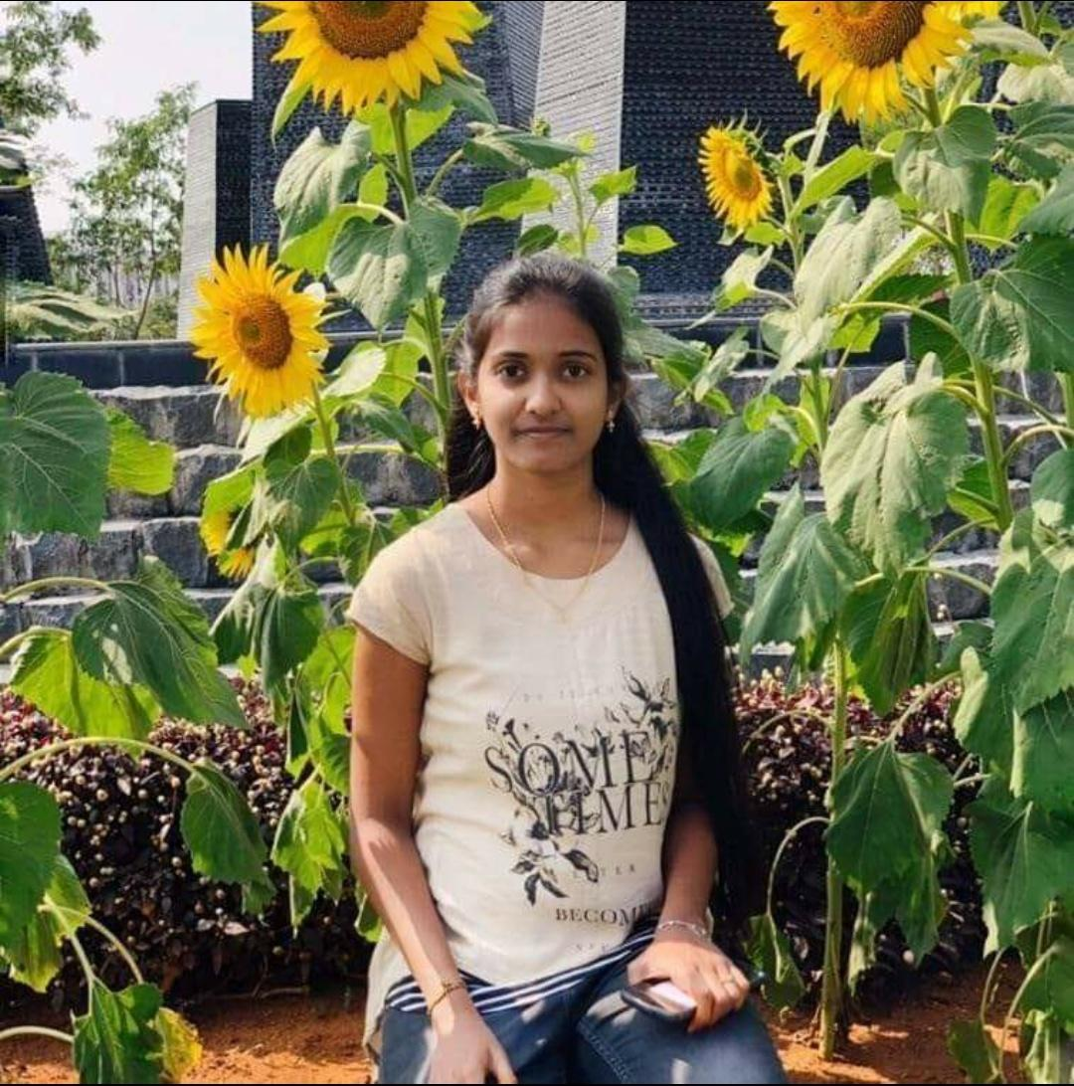
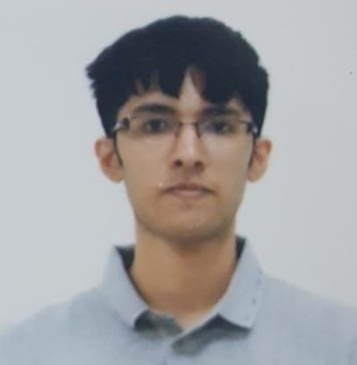
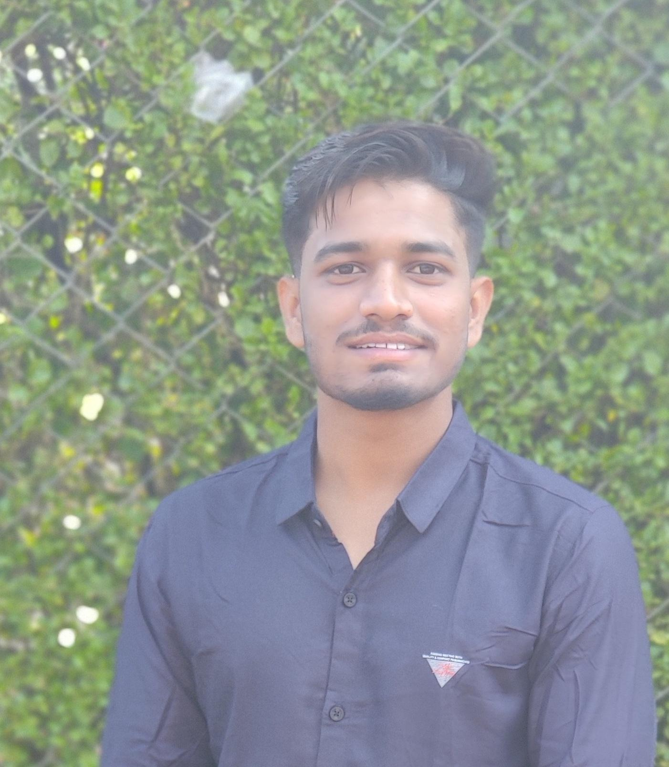
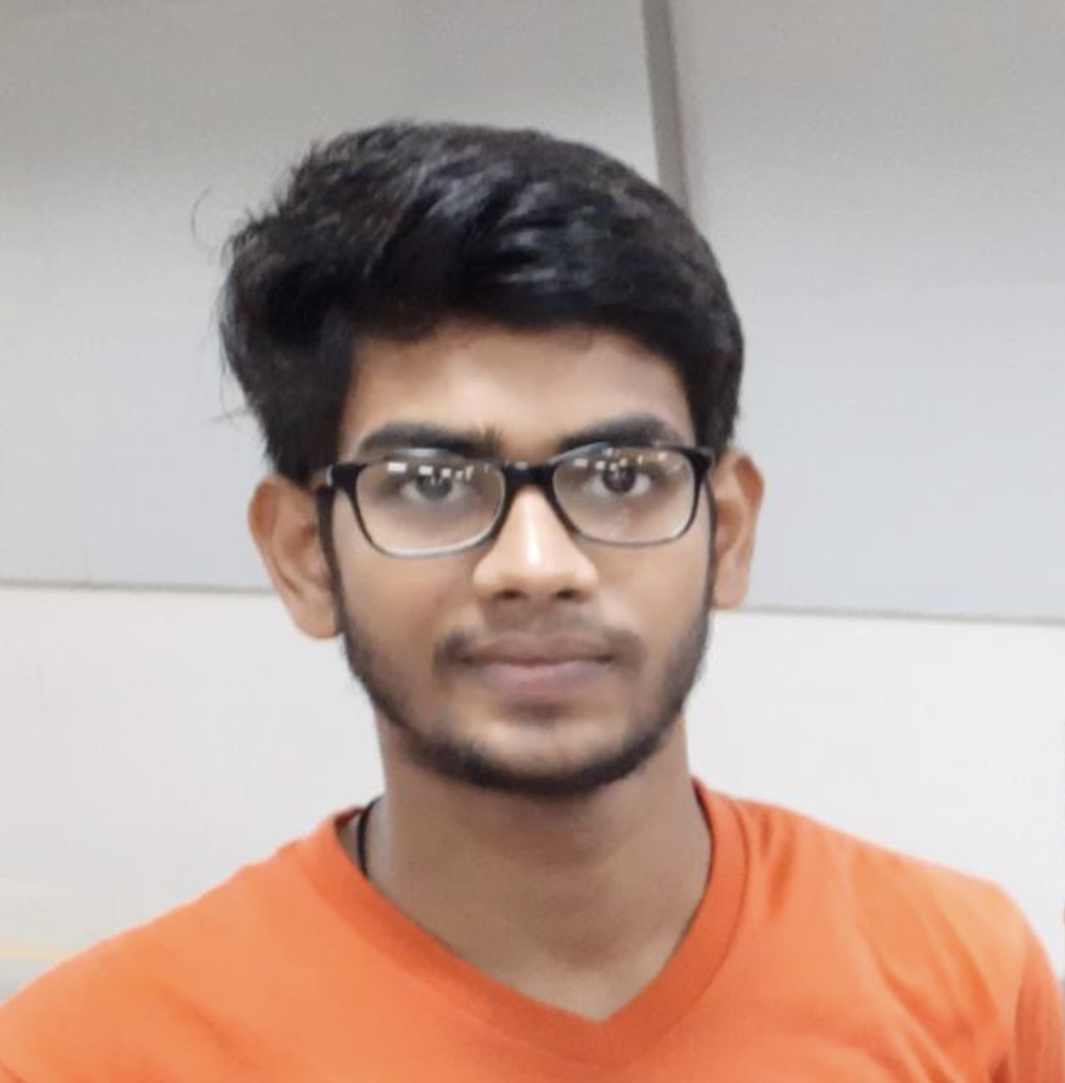

Team Overview
Vikram (TL)
Vennela
Nitin
Pooja
Rishabh
Satyam

Slide 5

Agenda
01
Brief overview of the Case Study
02
Project Milestones
03
Tech Stack
04
Development Cycle
05
Engineering Practices
06
Learnings & Challenges
07
Demo
08
Questions
Notes:
Time – 1 min

Slide 6
Brief Overview of the Case Study

Slide 7
Register courses
Add/Drop course
Register himself
Fee Payment
View Course Catalog
View Grades alloted
Student
Course Management System (CRS)
Admin
Add/Remove user
Approve Student
Add/Delete courses
Update Catalog
Generate Report
Grade students
View Course Catalog
View courses to teach
Professor

Slide 8

Business Code
Database Code
UI
Mysql
DB
Browser
(Client Package)
(Service Package)
(Dao Package)

Slide 9

Project Milestones
Project Milestones

Slide 10
01
Understanding the Problem Statement
Coming up with UML diagrams which further narrowed the scope of the project
Problem Statement
02
Defining Bean, Business, DAO, and service classes.
Implementing the Database structure with proper restraints
Code Structure
03
Divide and Conquer.
Collaborating through git, maintaining coding style for uniformity.
Module developments and later, end-to-end flow.
Implementation
04
Adding additional validation checks for Bean classes and user inputs.
Adding custom exceptions, Notification System, singleton classes.
Adding Validations, exceptions, singleton classes.
05
Migrating the whole CRS to RESTful service.
Resolving dependency conflicts.
Migrating to Dropwizard and demo the end-to-end flow.
REST migration, followed by Dropwizard

Slide 11










Tech Stack

Slide 12
Development Cycle
Testing
Validations, Unit tests
Requirement Collection
Understanding the Problem statement
05
01
04
CRS
Coding
Console, REST, Dropwizard
Analysis
Choosing tech stack
Class design
02
03
Designing
UML Diagrams Database design

Slide 13

Learning & Challenges
Key Learnings
Defining project structure and database from scratch. (End-to-end development)
Divide and Conquer: We effectively divided our goals, which made the project modular and easy to migrate.
Collaboration tools like GIT, Draw.io (for UML)
Ownership, Bias for Action.
Major Challenges
Collaborating in a remote environment.
Resolving merge conflicts on GIT.
Resolving Dependencies due to different operating systems of team members.

Slide 14

CRS DEMO

Slide 15


Slide 16

Thank you

